Slide 1
Groundwater Contaminant
Fate & Transport Modeling
EPD Guidance
Land Protection Branch
Robin Futch, P.G.
Carolyn Daniels, P.G.
Allan Nix
Geologist/Compliance Officer, RRP/LPB/EPD
GEORGIA VRP WORKSHOP V
October 18, 2016

Slide 2
Groundwater Modeling Guidance
General guidelines for the application of groundwater contaminant fate and transport models recently finalized. Document is for guidance only for use at sites with groundwater contamination that are subject to regulation by the Georgia Environmental Protection Division (EPD) under the following statutes:
Federal Resource Conservation and Recovery Act (RCRA)
Federal Comprehensive Environmental Response, Compensation, and Liability Act (CERCLA)
Georgia Hazardous Waste Management Act, O.C.G.A. 12-8-60
Georgia Hazardous Site Response Act (HSRA), O.C.G.A. 12-8-90
Georgia Voluntary Remediation Program Act (VRPA), O.C.G.A. 12-8-100
Georgia Brownfield Act, O.C.G.A. 12-8-200
Georgia Underground Storage Tank Act, O.C.G.A. 12-13-1
Georgia Solid Waste Management Act., O.C.G.A. 12-8-20
Notes:
GW modeling guidance – developed to provide further guidance/clarification on how EPD reviews submitted models . Applies to all land protection branch programs.
Voluntary Remediation Program – models as part of the CA along with other tools to achieve site closure
- signed into law June 1, 2009
- began accepting applications – January 1, 2010

Slide 3
Groundwater Modeling Guidance
The guidance is not a substitute for professional judgment, which must be applied in the selection and application of fate and transport modeling, nor does it advocate modeling over the collection and interpretation of quality media-specific site data.
All corrective action methods may be considered under the Voluntary Remediation Program. Compliance with site-specific cleanup standards may be determined on the basis of accepted fate and transport models per the Voluntary Remediation Program standards and policies outlined in OCGA 12-8-108.
The Guidance will be posted on the EPD website by end of October - the link will be sent to all attendees when it is posted.
Notes:
GW modeling guidance – workgroup began developing guidance in 2011
Will be posted on the EPD website shortly – link will be sent out to all attendees when posted

Slide 4
Groundwater Modeling – General observations
The quality of the output is directly related to the quality of the input. The preliminary conceptual site model, submitted with VRP application, should be continually updated as the investigation and remediation progresses.
Key questions to ask when fate and transport modeling identified as part of a site remedy:
1. Will groundwater contaminants reach sensitive receptors at unacceptably high concentrations?
If YES, when in the future will it impact receptors – that data should define performance monitoring period.
Notes:
WILL IMPACTED GROUNDWATER ADVERSLY IMPACT SENSITIVE RECEPTORS? AND IF SO – WHEN?

Slide 5
Does the EPD have a list of approved groundwater models?
Not really. EPD does however offer these guidelines:
Preference is for readily available, widely distributed, and generally accepted models
Prefer public domain models over proprietary -- most were developed by or for government agencies such as EPD, USGS, and USDoD. Consequently they have been subjected to peer review and have case histories outlining their limitations and drawbacks.
EPD may consider models developed using other software, if documentation is provided demonstrating the software has been verified, peer-reviewed and well documented
EPD Compliance Officer and/or Geologist should be provided with enough data to run the model, to confirm it can be replicated.
Notes:
EPD has no specific recommendations or preferred models – staff would just like to be able to replicate the model with provided inputs or discuss with modelers – when we do not have access to the modeling software.

Slide 6
Commonly Used Fate and Transport Models for Groundwater
Analytical
Analytical models typically assume uniform hydrogeologic and environmental conditions throughout the site. Largely appropriate for less complicated sites.
Examples: Bioscreen, RemCHLOR (Remediation Evaluation Model for Chlorinated Solvents), and Biochlor
Numerical
Numerical models generally allow for variation of hydrogeological and environmental conditions throughout the site. Generally more applicable to sites where the field data show that groundwater flow or contaminant fate and transport processes are relatively complex.
Examples: MODFLOW with Contaminant Transport Model such as MT3D or RT3D

Slide 7
Considerations when choosing a Model
Know what the proposed models assumptions and limitations are.
Is the data set robust enough, i.e., sufficient monitoring points and sampling event data, to construct a representative fate and transport model?
Models typically make assumptions about hydrogeologic and environmental conditions throughout the site. Is your CSM simple or complex? Pick the model that works best with your site.
The CSM used for development of a model should adequately represent the physical and chemical aspects of the hydrological and geochemical processes to be modeled. It should reflect new data and interpretations as they are developed.

Slide 8
Considerations when choosing a Model
5. Don’t skimp on collecting site-specific data to get the best representation of site conditions:
- Slug tests – tend to underestimate permeability. Surge wells prior to conducting slug tests to get best permeability. Do more tests rather than less.
- If dealing with organics, collect samples to estimate f_{oc} (fractional organic carbon)
6. Accurate source characterization is essential. Models are generally sensitive to width, depth, and strength of the source area.
7. More than one round of sampling data and data from more than one well is required to develop a representative model.

Slide 9
Construction of the Model
The design of the groundwater model should adequately represent both the data available and the CSM, and should meet the modeling objectives. The model design should include, but not be limited to:
Model layering
Aquifer and Confining Unit Properties
Boundary Conditions
Aquifer Recharge and Discharge
Chemical Properties and Transport Processes
Baseline Stresses
Steady State or Transient Simulations

Slide 10
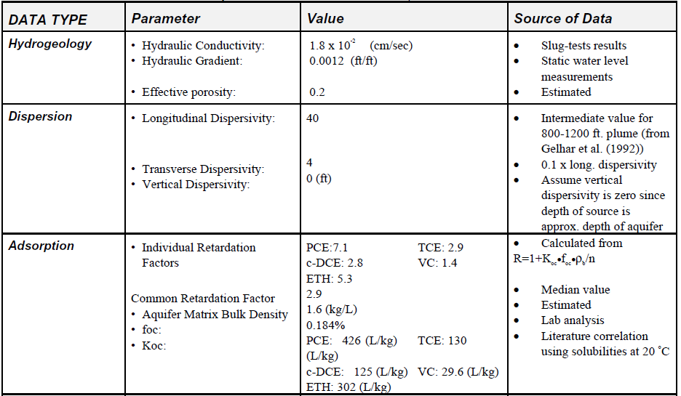
Construction of the Model
Inputs should be based on field data and, in some cases, appropriate peer-reviewed literature values - The values of all inputs for each model, node, or cell should be specified in tabular and graphical or map format, as appropriate. The source of the values should be specified as shown in the table below (Source: BIOCHLOR Users Manual, 2000).
If a literature value is used, please provide the bibliographic reference, If field acquired data is used, please provide a reference to the submittal it was reported in. Provision of the ranges of values published in the literature reference or acquired through field data is also very helpful in reviewing the model.

Slide 11
Model calibration
Calibration should proceed by first changing those parameters with lowest level of accuracy and then fine tuning the simulation by adjusting other parameters.
Typically model calibration is conducted using a timeframe beginning with the known or assumed release date and ending with the date of collection for a field collected data set selected by the modeler.
The model is then validated using one or more additional data sets which may have been collected before or after the set used to initially calibrate the model.
The calibrated/validated model is then used to predict what happens when an existing condition is allowed to persist into the future (for our purposes, until the worst-case conditions occur) or to show a response to a change in conditions.

Slide 12
Model calibration
Contaminant fate & transport models are typically most sensitive to a variety of inputs
Field Measured: Source character width, strength, depth and thickness; Permeability (controls groundwater flow rate); and Kd (controls contaminant retardation), foc and pH dependency
Field Measured or Calibration Derived: “In Plume”decay rates (control plume expansion); “Source” decay rate (controls source concentration and persistence)
Calibration Derived - Dispersivity (controls dilution through spreading of contaminants)

Slide 13
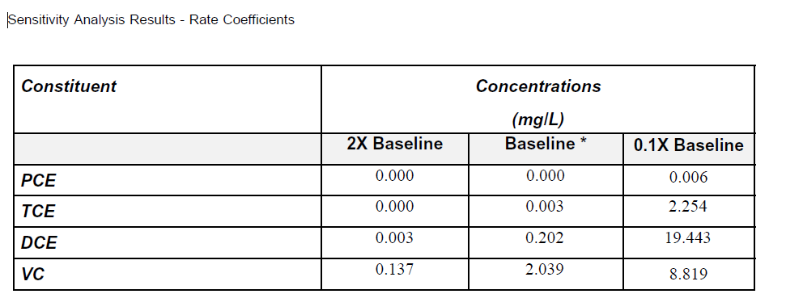
Sensitivity analysis
Sensitivity analysis should be performed to determine the relative impact of changes in model input parameters on the model output. Some input parameters are more important in determining model outcomes than others → Their relative importance can be influenced by site-specific conditions and the properties of the contaminants being modeled.
The relative sensitivity of model results to each tested model input parameter and boundary condition should be documented.
(Source: BIOCHLOR Users Manual, 2000).

Slide 14
Biochlor
BIOCHLOR -- an analytical model intended for use as a screening-level model to determine if remediation by natural attenuation is feasible at a chlorinated solvent site; model can predict migration patterns of a parent chlorinated solvent species (either TCA or PCE) and its daughter products.
BIOCHLOR has two inherent limitations: (1) it averages the retardation effects and (2) it can only model a single sequential reaction chain.
Assumes simple groundwater flow conditions; should not be used where vertical flow gradients affect contaminant transport.
Assumes uniform hydrogeologic and environmental conditions
In biotransformation mode – designed for simulating sequential reductive dechlorination of chlorinated ethanes and ethenes.
BIOCHLOR – most common model submitted to EPD for VRP corrective actions

Slide 15
Groundwater models – relevant site-specific data to collect
When a fate and transport model is likely to be part of the final remedy for a site, additional inexpensive data relevant to the development of the groundwater model should be collected:
Grain-size Analysis with Hydrometer Method – to estimate n_{e} & matrix bulk from literature (fines must be reported as silt and clay fractions for this)
Fractional Organic Carbon (foc) –
Walkley Black Method -Results are usually reported as % organic carbon content. The reported value can be converted to a fraction by dividing by 100.
Fractional organic matter content (ASTM Method 2974) - Divide reported result by 1.724 to estimate foc.
Slug tests

Slide 16
Groundwater Modeling Deliverables
Input and output sheets for the following model runs: Calibration Simulation; (2) Validation Comparison Simulation; (3) Maximum Plume Extent Predictive Simulation; and (4) Applicable Groundwater Cleanup Standards.
A contaminant plume map and cross-sections that show the source dimensions used in the model: length, width, and source thickness.
A table summarizing predicted contaminant concentrations vs field-measured concentrations along the plume centerline:

Slide 17
Groundwater Modeling Deliverables
Model Calibration and Validation: The model should be both calibrated and validated for EPD to be able to replicate and concur with any conclusions based on it.
Modeled Maximum Projected Extent of the Contaminant Plume: The simulation time for a properly calibrated and validated model should be extended until the contaminants begin to retreat or reach asymptotic levels. Output sheets representing the predicted year(s) that the contaminant plume(s) ceases to migrate downgradient, and the plume conditions on the animation dates immediately before and after the output sheet referenced above showing the plume migrating forward before and retreating or stabilized afterward.

Slide 18
Common deficiencies with groundwater Modeling Deliverables
Lack of documentation – no sources/justification provided for input values used in model. This information should be provided in tabular format in addition to a narrative.
Input values, when provided, are often not used in the model runs or incorrectly entered.
Representative start date for release – many models do not reflect when impacts began, i.e., when business began operation or source removed. If the source has been removed, there may be other options.
Models with only 1 well have been submitted. At a minimum there should be 2 wells and if only 2 wells, justification needs to be provided. 3 wells (or more) are preferred.
Wells in the centerline of the plume (POD) should be used for calibration and as POD wells during performance monitoring.
For each model run, the corresponding screen shots are not provided as paper copies for all VOCs.
Sensitivity analysis is not conducted and no discussion provided.
Conclusions relative to modeling objectives not provided.

Slide 19
Questions??

