Slide 1
Voluntary Remediation Program Update
David Hayes
Voluntary Remediation Unit Coordinator
GIEC Workshop
December 4, 2018

Slide 2
Voluntary Remediation Unit
Purpose: Administer the Voluntary Remediation Program (VRP) in an objective, consistent, and timely manner, in accordance with the VRP Act.
Personnel:
David Hayes (Unit Manager) Will Lucas Gordon Terhune | Susan Kibler Mike Smilley Nicole Vermillion

Slide 3
Voluntary Remediation unit Formation
Reasons for forming unit:
Discussed since VRP inception, similar to Brownfield Unit
Greater EPD focus on successful implementation
Greater consistency in EPD review and Act interpretation
Process:
Began in Feb. 2018
Approx. 130 sites transferred by July 2018
Sites transferred when new VRP Application received

Slide 4
Voluntary Remediation Unit Formation
Benefits so far:
More EPD focus on improving VRP implementation
More EPD staff focus on VRP process / sites
More consistency with EPD reviews (e.g., GW modeling)
More coordination between Brownfield / VRP
Going forward:
Improve response times, focus comments on end goals

Slide 5
Why enroll in the VRP?
More flexible framework to meet compliance obligations
Update compliance status
Make property “Brownfield Ready”
Make sure cleanup meets all Brownfield requirements (source material, use of controls)
Defer HSI listing (case-by-case basis)
Framework for EPD concurrence with investigation / cleanup that is not otherwise regulated

Slide 6
VRP Process
Application: Corrective Action Plan (CAP) or Compliance Status Report (CSR)
Must meet eligibility requirements
$5k application fee, EPD review invoiced at $75/hour
Semi-annual progress reports
Final CSR certifying compliance with cleanup standards
Finalization and filing of Uniform Environmental Covenant (UEC) if relying on controls
Note: EPD seeks consent orders to extend projects beyond 5 years

Slide 7
VRP Project Status

Slide 8
VRP and the hazardous site inventory
VRP Applications: % on HSI
HSI Delistings in Last 3 Years

Slide 9
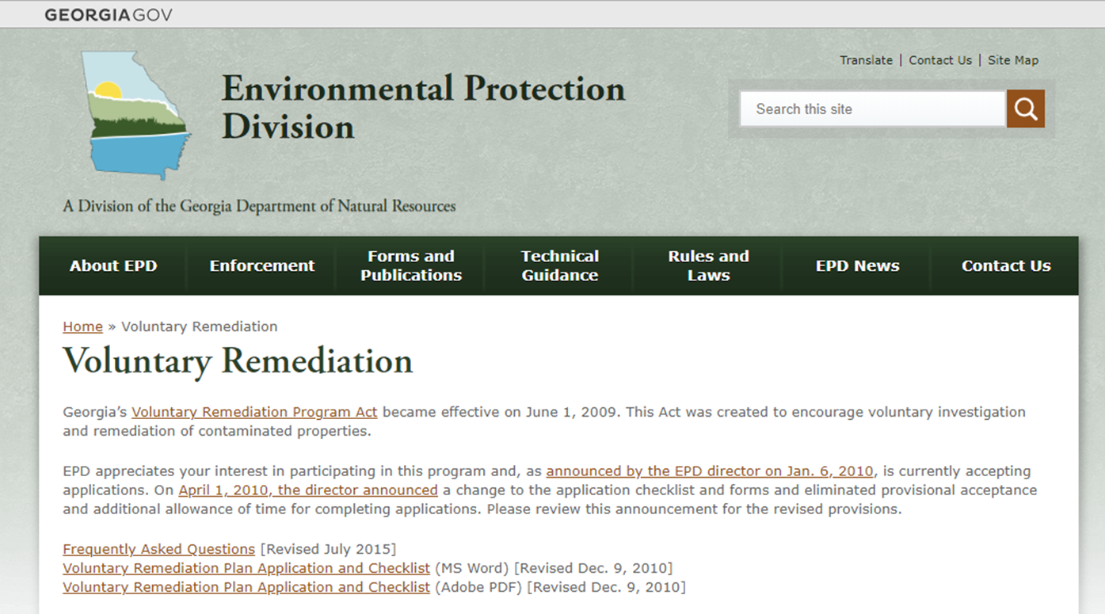
VRP Webpage
www.epd.georgia.gov/voluntary-remediation

Slide 10
VI Technical advisory Committee
Beginning in January 2019
Committee Members
Bart Eklund (env. scientist) | Jim Fineis (geologist)
Ryan Jones (env. scientist) | Leslie Miller (engineer)
Andrea Rimer (attorney) | Katie Ross (geologist)
Chris Saranko (toxicologist) | Keith Ziobron (engineer)

Slide 11
QUESTIONS

