Slide 2
Vision for Land Protection branch
Goals:
•Productive land
•Healthy citizens
•Vibrant economy
Through:
•Preventing harmful releases to land
•Restoring the land when needed
•Promoting resource conservation

Slide 3
Branch Organization
CHUCK MUELLER, Branch Chief
Sarah Visser, Assistant Branch Chief
William Cook, Program Manager, Solid Waste
Lon Revall, Program Manager, UST
Jim Brown, Program Manager, HW Corrective Action
Jane Hendricks, Program Manager, HW Management
Jason Metzger,
Program Manager, Response & Remediation
MSW & Industrial Landfills
Environmental Monitoring
Surface Mining
Scrap Tire Compliance
Inspections & Enforcement
Private Party Cleanups
EPD Managed Cleanups
RCRA Remediation
NPL Sites
Lead & Asbestos
RCRA Permitted Facilities
HW Generators
DOD Facilities
HSI & Abandoned Sites
HSRA Remediation
Voluntary Remediation
Brownfields
Risk Assessment
Waste Reduction

Slide 4
Program Organization
Jason Metzger
Program Manager
Kevin Collins
RDU2 Unit Manager
David Hayes
VRP Unit Manager
David Brownlee
RDU1 Unit Manager
Shannon Ridley
Brownfield Unit Mgr
Andy Taft
PA/SI Sub Unit
36 Funded Positions

Slide 5
LAND Initiatives
HSRA Rule Change
Guidance Development – Drafts
Area Averaging
Soil to Groundwater Leaching Pathway
VRP Unit Transition
Environmental Covenant Template Updates
Digital Copies of Notifications
Contractor and Staff-led Investigations and Cleanups
Site Prioritization / Timely Reviews / Collaborative

Slide 6
Georgia epd online system
Voluntary Remediation Program Application
Brownfield Application
Lead / Asbestos Abatement Notification / Certification / Accreditation
Haz Substance and Haz Waste Fee Reporting / Payment
Scrap Tire Generator / Carrier / Sorter / Processor
Trust Fund Reimbursement Requests
UST Notification / CAP / Reporting

Slide 7
Georgia epd online system

Slide 8
GEOS
In Progress – Scheduled for 1st Q 2019
All Brownfield and VRP Reporting
Visibility to Submittals and Responses
Solid Waste Handling Permits
Permit-By-Rule
Solid Waste Reporting

Slide 9
On the Horizon
Finalize Area Averaging and Leaching Guidance
Vapor Intrusion Technical Advisory Committee
Georgia Risk Assessment Guidance
Future Rule Changes
PFAS / PFOA?

Slide 10
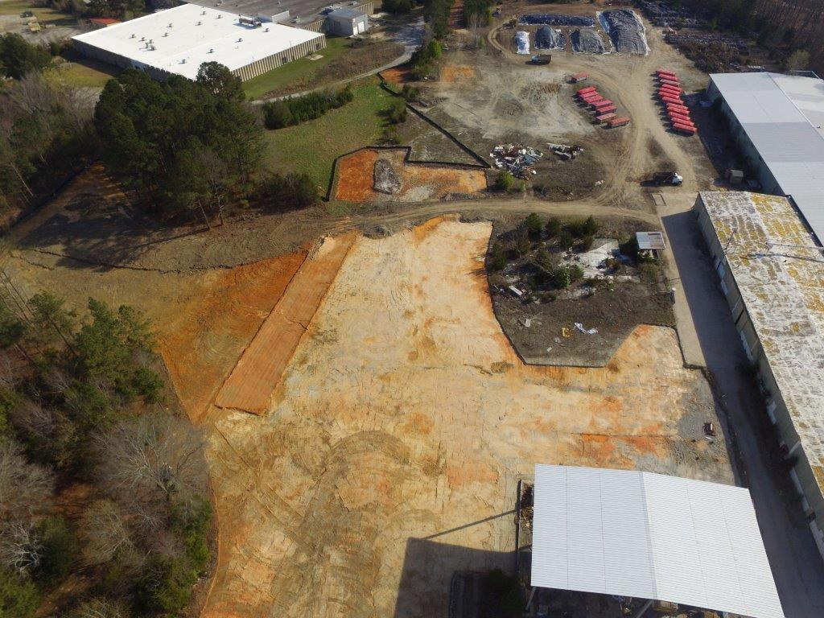
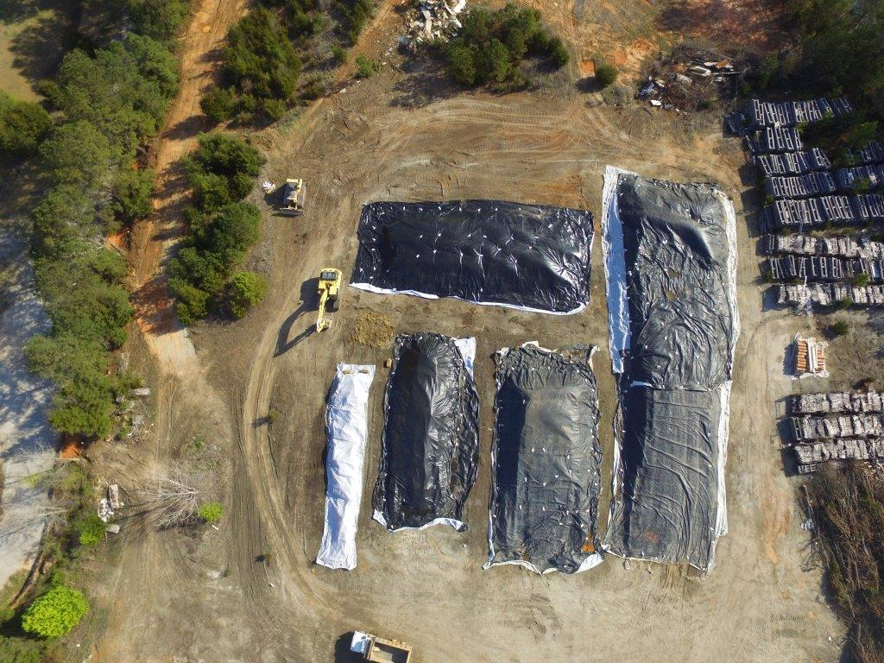
HAZARDOUS Waste Trust fund
Up for Reauthorization in 2019
Solid Waste tipping fees, Generator fees, Penalties
Reimburse local government landfill costs
Abandoned site cleanups

Slide 11
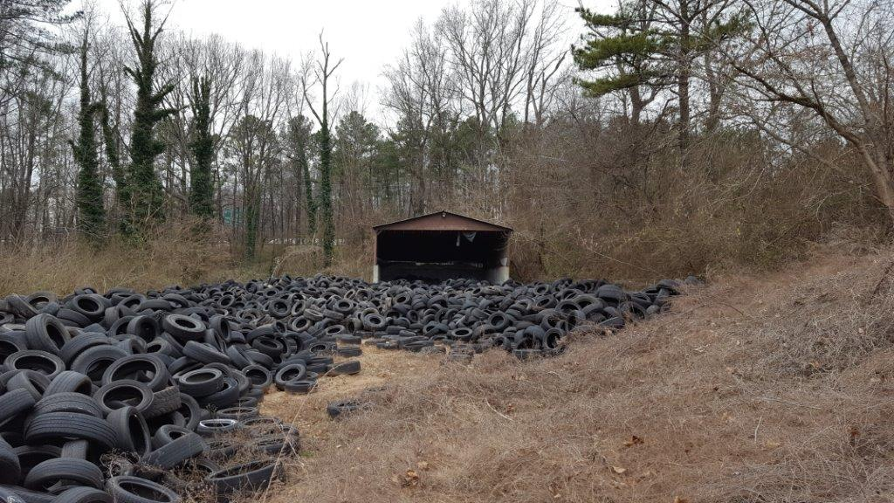
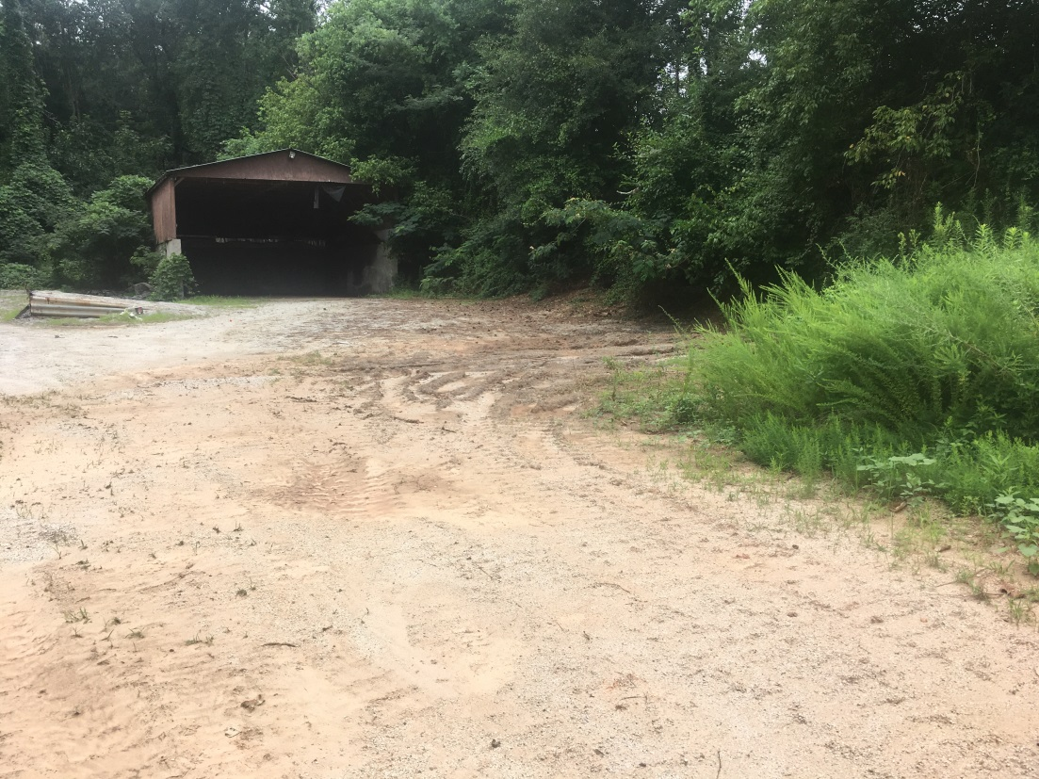
Solid Waste Trust Fund
Up for Reauthorization in 2019
Funded by new tire fee
Reimburse local government for scrap tire costs
Abandoned landfill investigation and closure

Slide 12
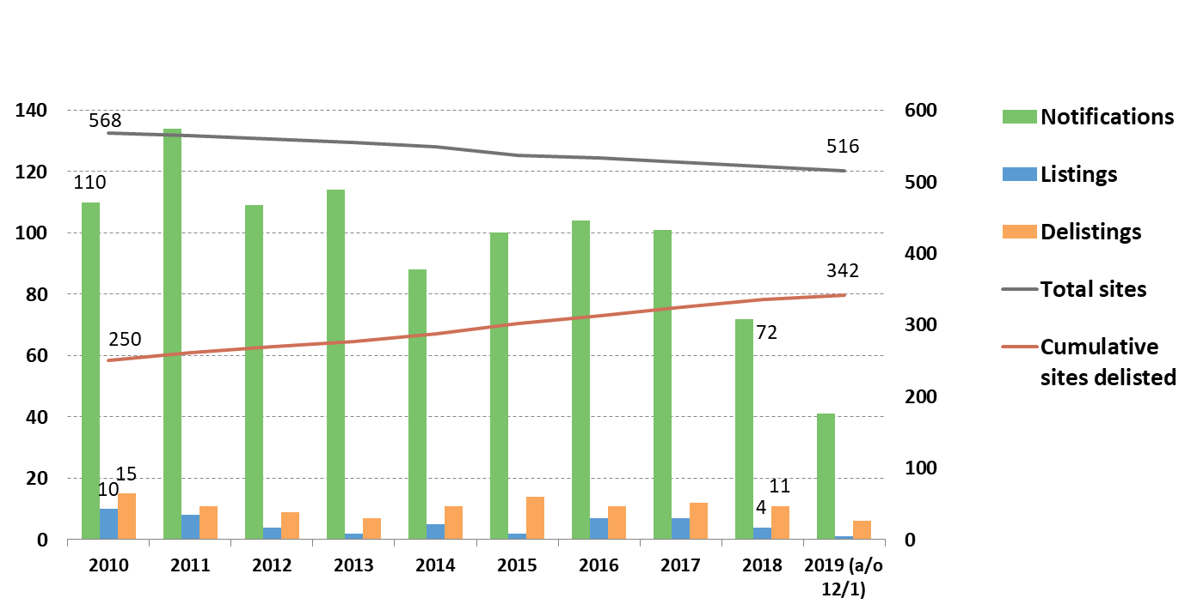
Hazardous Site Inventory

Slide 13
Brownfield Applications

Slide 14
Jason Metzger
Response and Remediation
Program Manager
jmetzger@gaepd.org
404-657-8606

